Slide 1
Statistics for Soil Survey

Slide 2
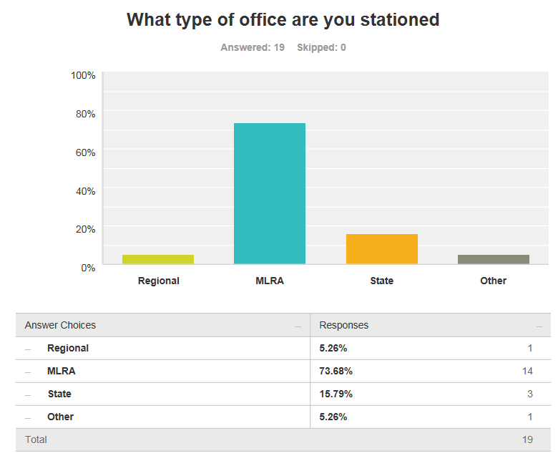
Pre-course Questionnaire

Slide 3
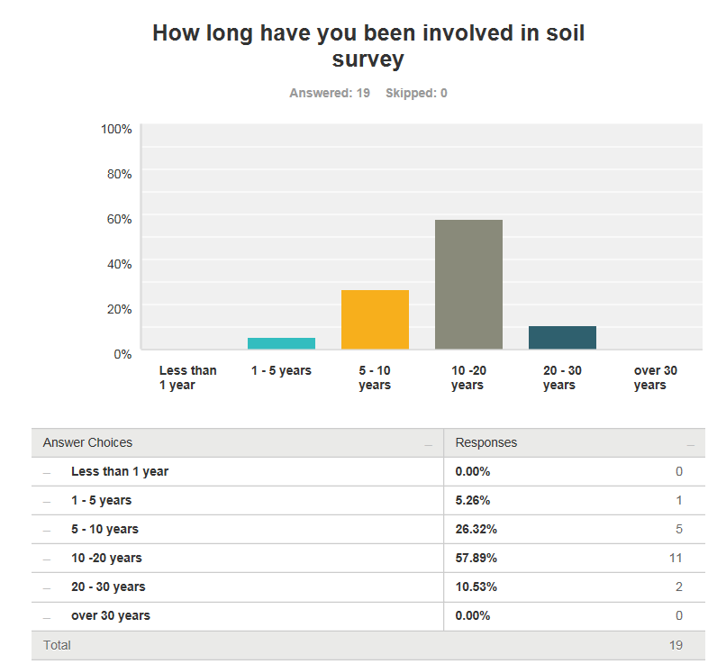
Pre-course Questionnaire

Slide 4
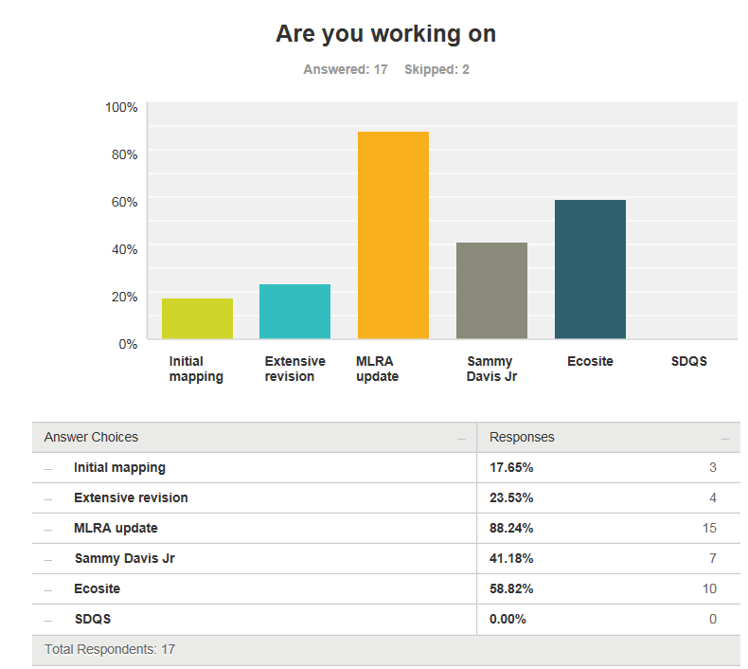
Pre-course Questionnaire

Slide 5
Pre-course Questionnaire
Current Soil Survey Procedures
GIS – select and evaluate polys(smu) and pedons – zonal stats
GIS – SDJR purposes for seamless interps across artificial boundaries
GIS – QA/QC of SSURGO and digital soil mapping
GIS – Knowledge Based inference using ArcSIE
R – used for exploring data in correlation process
NASIS – typical workload

Slide 6
Pre-course Questionnaire
Current Statistical Procedures
Move data to Excel then – descriptive statistics and graphs
R - descriptive statistics and graphs
Other software -
ArcGIS – zonal stats
None

Slide 7
Pre-course Questionnaire
Goals for this training
Learn about statistical analysis
Expand existing knowledge of statistical techniques
Learn ways to more fully utilize existing data – NASIS, KSSL, SSURGO etc.
Learn ways to investigate soil map units, components, pedons etc. more objectively
Use objective data to update spatial and tabular
Use R with raster data for mapping purposes
Data mining

Slide 8
Course Objectives
Develop solutions to investigate soil survey correlation problems and update activities.
Evaluate investigations for interpretive results and determine how to proceed.
Create a continuous surface from point data.
Summarize data for populations in NASIS.
Help to pursue the question “why”

Slide 9
Overview: Why Is This Training Needed?
Long standing goal of the Soil Science Division to have a course in statistics
Opportunities to learn these techniques are limited, especially at the undergraduate level
Consistent methodology (data analysis, data population, sampling design, etc.)
There is continually a greater need to use these techniques:
Mapping of lands at high production rates
Ecological Sites
Soil survey refinement (disaggregation)
Notes:
Need identified about 10 years ago. Alignment of software and staff are available now.

Slide 10
Overview: Why is course organized this way?
Our best judgement for assembling into 24 hours what could be 6 University level courses
Mixture of slides and script enabled web pages is new for NRCS
The web content is a long-term investment and should serve as a permanent reference
Feel free to provide guidance for improving the class for future offerings

Slide 11
Overview: Week 1
These are general guidelines
Day 1
Introduction
Data We Use
Day 2
Data We Use
Sampling Design
Day 3
Exploratory Data Analysis
Clustering and Ordination

Slide 12
Overview: Week 2
Day 4
Week 1 Review
Clustering and Ordination
Validation and Uncertainty
Linear Regression
Day 5
Linear Regression
Logistic Regression
Day 6
Tree Models
Final Project

Slide 13
Final Project
Objective(s) - Describe what you will investigate and the methods that will be employed
Project Domain – could be confined to analysis of point data or horizons from KSSL or field descriptions, or include spatial component and resulting predictions
Results - Describe results using descriptive and graphical techniques. If predictions are used, include these
Discussion - Discuss how these results: 1) help in understanding the problem and 2) influence current and future investigations
Due date – March 24th, 2017

Slide 14
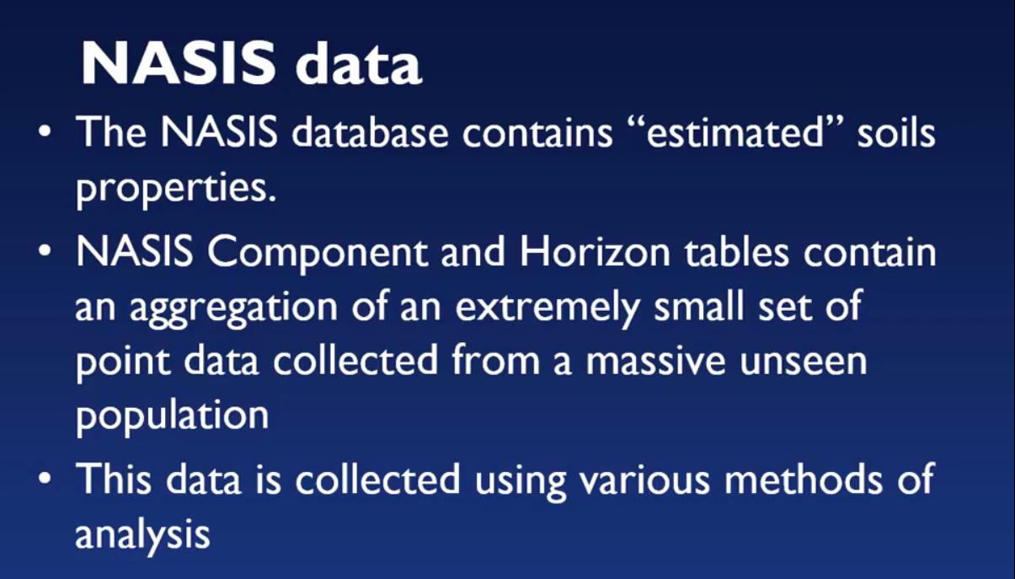
Pre-course Assignment: History of NASIS
Notes:
In Paul’s Youtube lecture, he discussed the difference between estimated and analyzed soil properties and presented an example of the importance of site selection. We as soil scientists have to extrapolate knowledge gained from a small set of point data to very large, unseen areas.

Slide 15
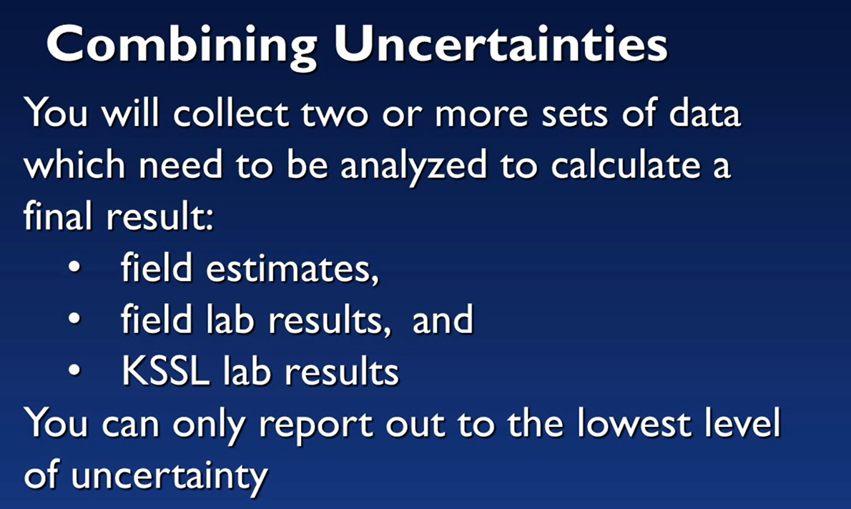
Pre-course Assignment: History of NASIS
Notes:
You should only populate NASIS with the lowest level of certainty, which is your field estimates. Do not populate NASIS with decimal points (lab precision/accuracy).

Slide 16
Pre-course Assignment: RStudio
In the pre-course assignment you:
Set your working directory and verified the RStudio version
Installed packages
Established an open database connection (ODBC) to NASIS
Ran fetchNASIS on a selected set

Slide 17
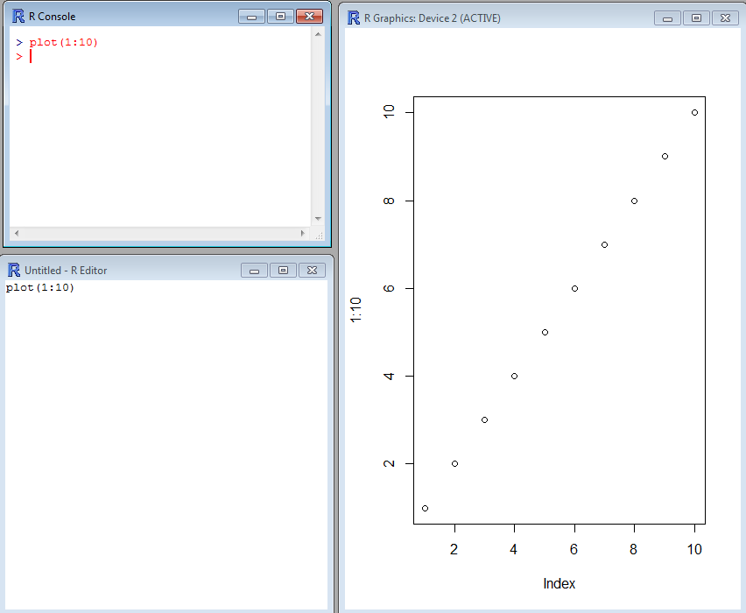
Introduction to R
R Console:
R code is typed here when it is ready to be executed.
R Graphics:
Graphics are displayed in this window after plot() or another graphics function is executed in R Console.
R Editor:
R code is typed here when it is in the process of being edited (you can also use notepad, notepad ++, etc.).
Notes:
There are two R that have been installed on your machine: R and RStudio. Both programs are command line driven and allow graphical display.
There are three main windows in R that you can use to conduct your data analysis: R Console, R Editor, and R Graphics. The R Editor window is simply a text editing window, you may also use notepad or notepad ++. The R Graphics window will only display when a command such as plot ( ) is executed.

Slide 18
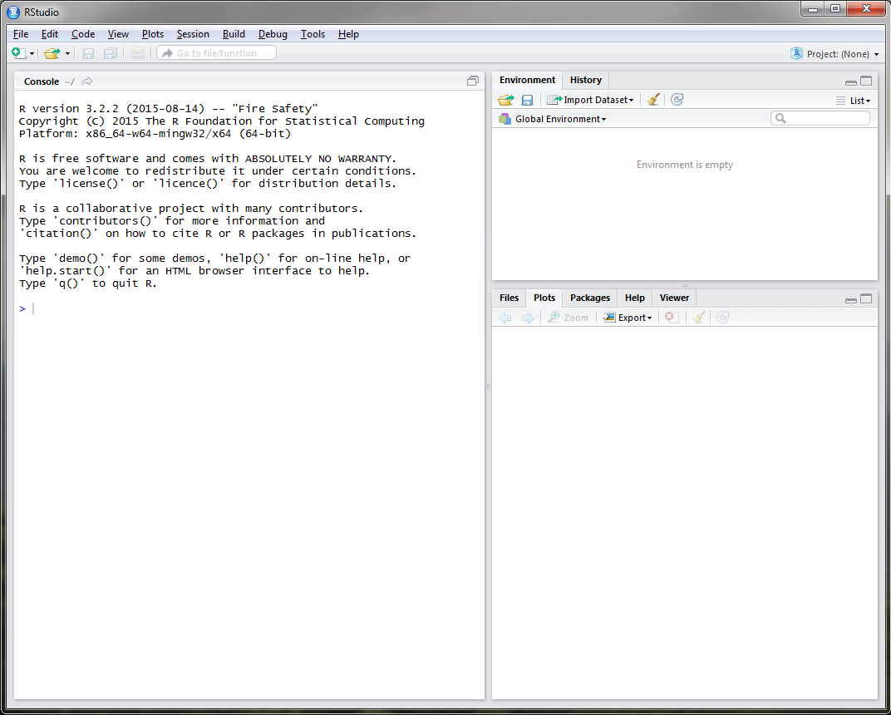
RStudio
Notes:
RStudio is similar to R GUI, but is more user friendly. When you open RStudio on your machine, you will see 3 windows: the console window, just like in the R GUI and two other windows composed of multiple tabs. The upper right window has two tabs: environment and history. The environment tab will allow you to import data and keep track of the data objects you create in R. The history tab keeps a record of all the commands that you execute. The bottom right window has 5 tabs: files, plots, packages, help, and viewer. The files tab allows you to navigate through folders similar to windows explorer. The plots tab will display and keep track of all of the plots that you generate. The packages tab allows you to install, load, and update packages using a GUI. The help tab allows you to search for documentation on R commands or packages. Unlike google, it will not allow you to search for things like cat sweaters or how to tie a tie. The viewer tab is for more advanced R users. We will not discuss it in this course.

Slide 19
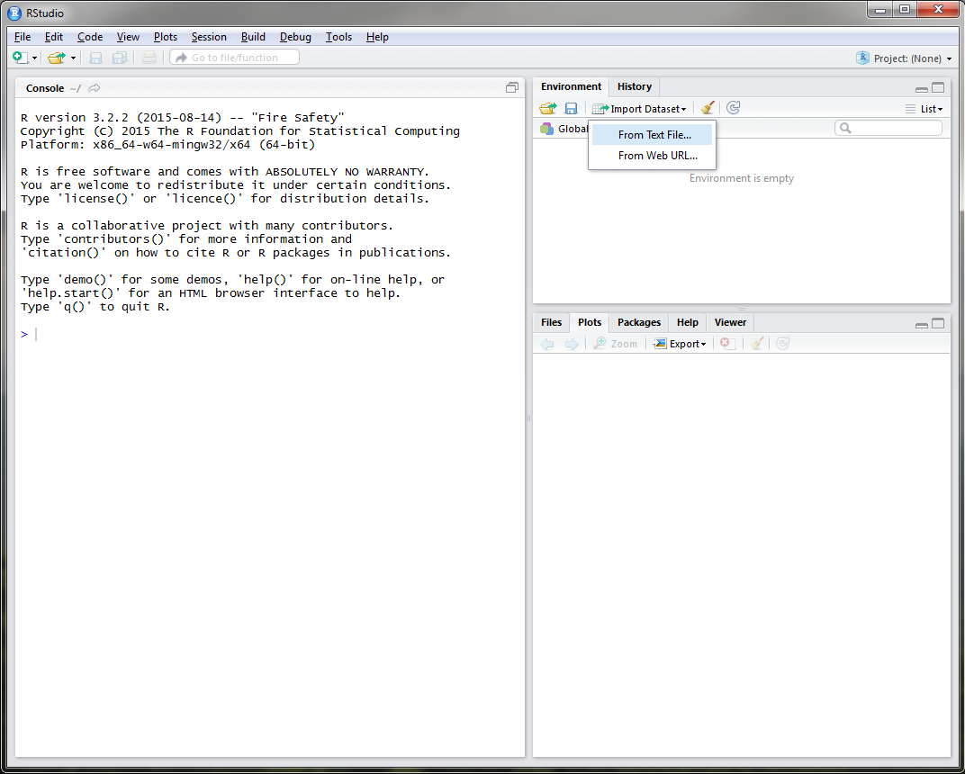
RStudio
Notes:
You can easily import data using the Environment tab.

Slide 20
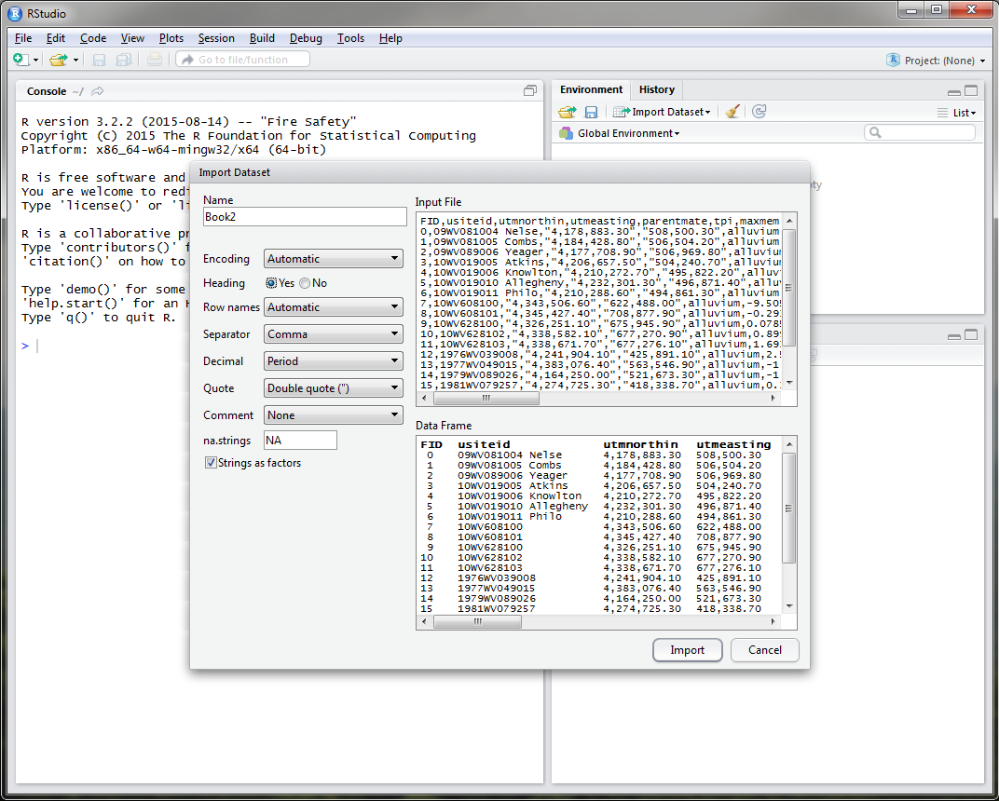
RStudio
Notes:
If you click import dataset, an import window similar to excel will appear.

Slide 21
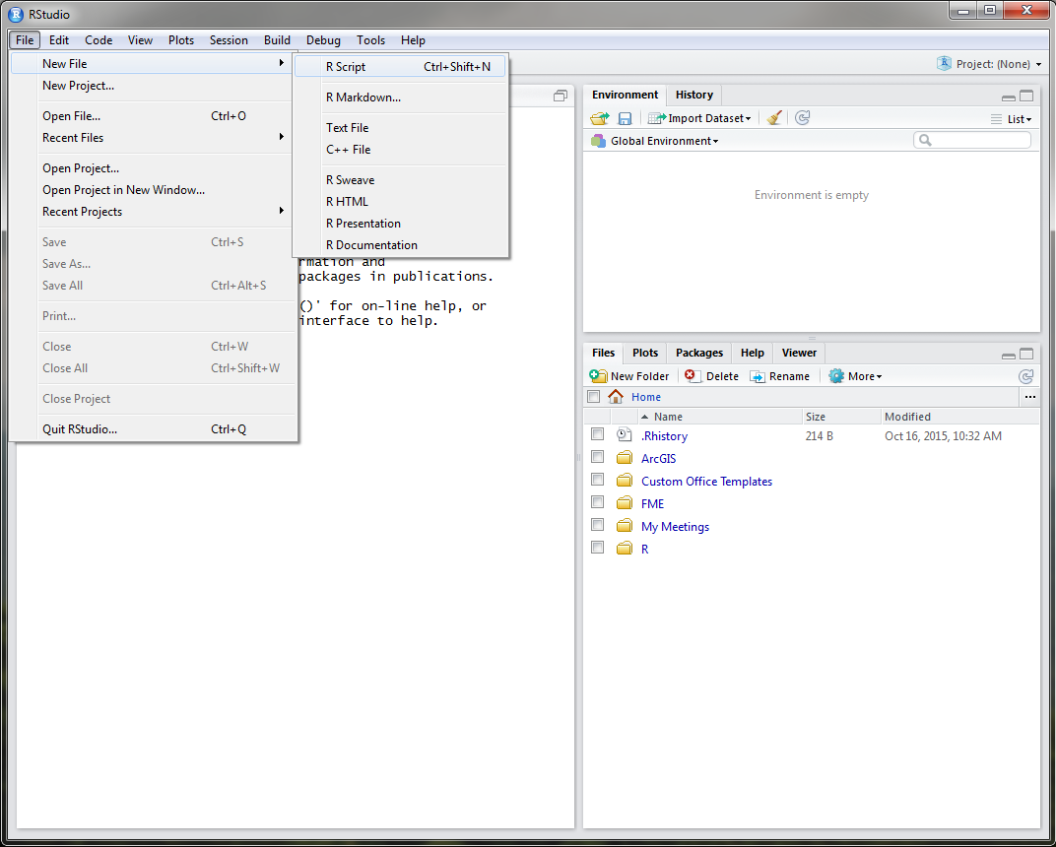
RStudio
Notes:
The text editor window, similar to R, can be opened in RStudio using the File drop down menu.

Slide 22
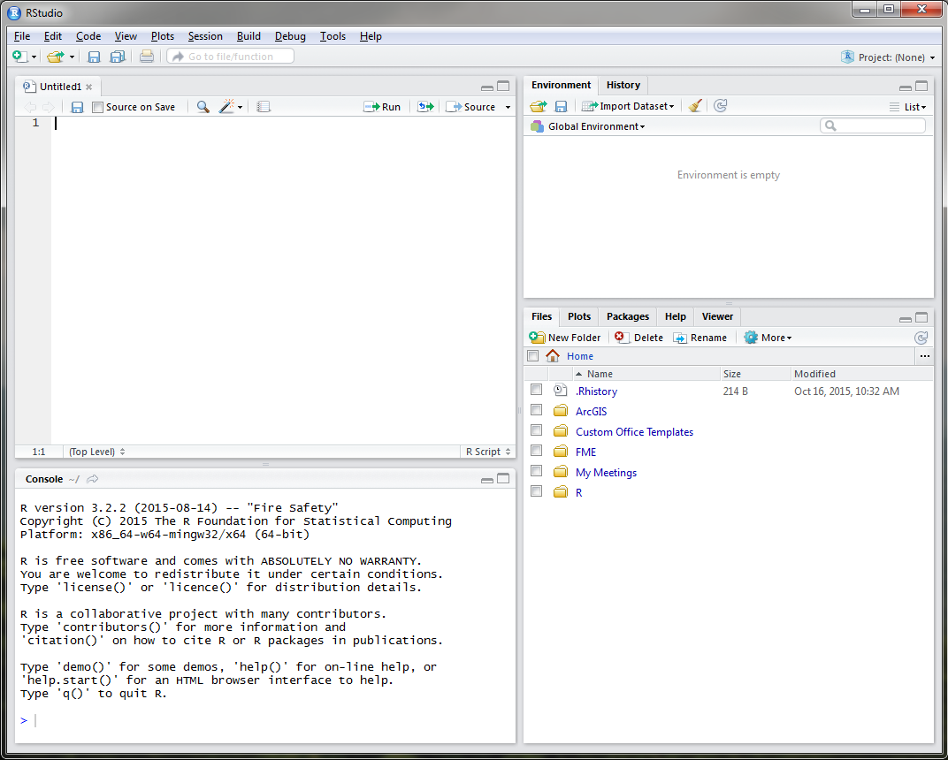
RStudio
Notes:
It is recommended to use the text editor window to develop your code before executing it in the console window.

Slide 23
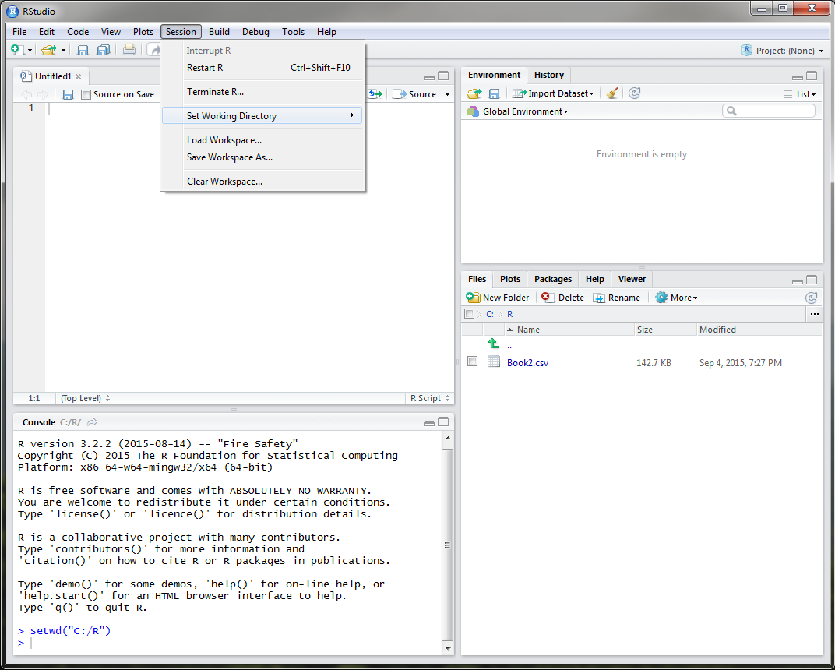
RStudio
Notes:
At the beginning of each R session, whether you are using R or RStudio, you want to make sure that you set your working directory. This directory should be where your input datasets are stored, R files are located, and will also serve as the default storage of plots or exported objects from R. To do this in RStudio, simply use the Session drop down menu. Notice that once you set your working directory, the Files tab in the bottom right window navigates to the directory that you specified, in this example, a folder called R on the C drive.

Slide 24
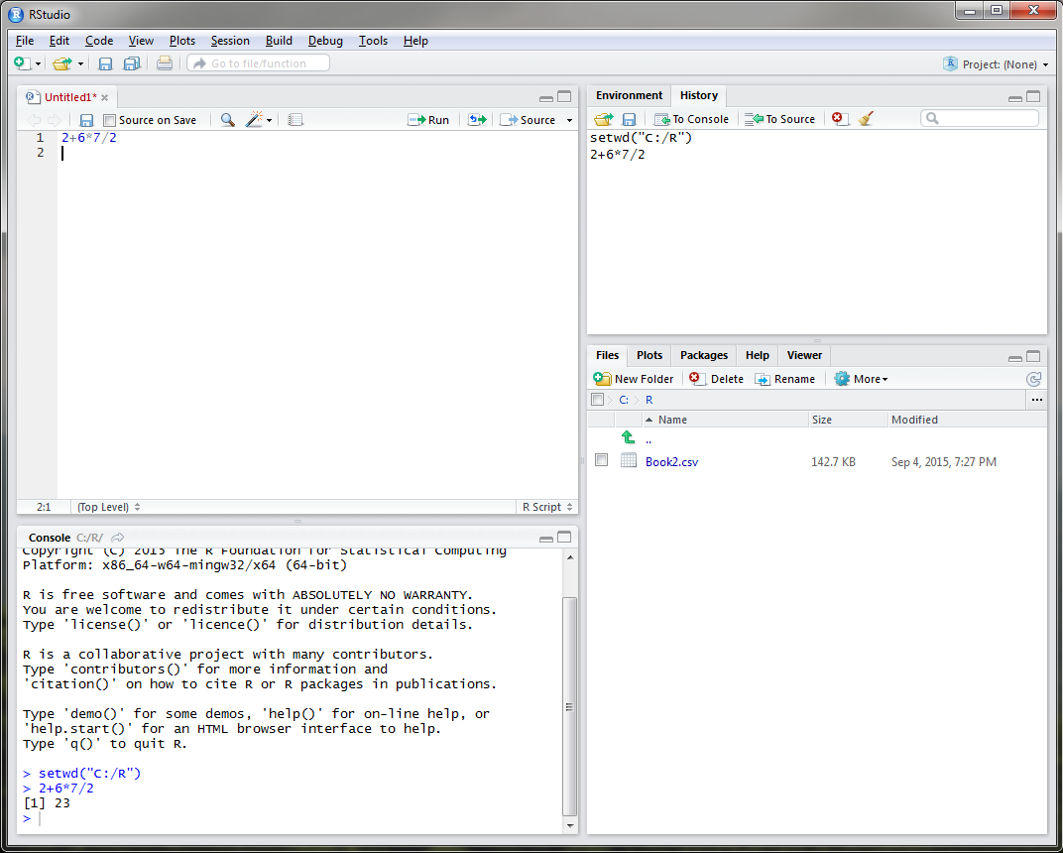
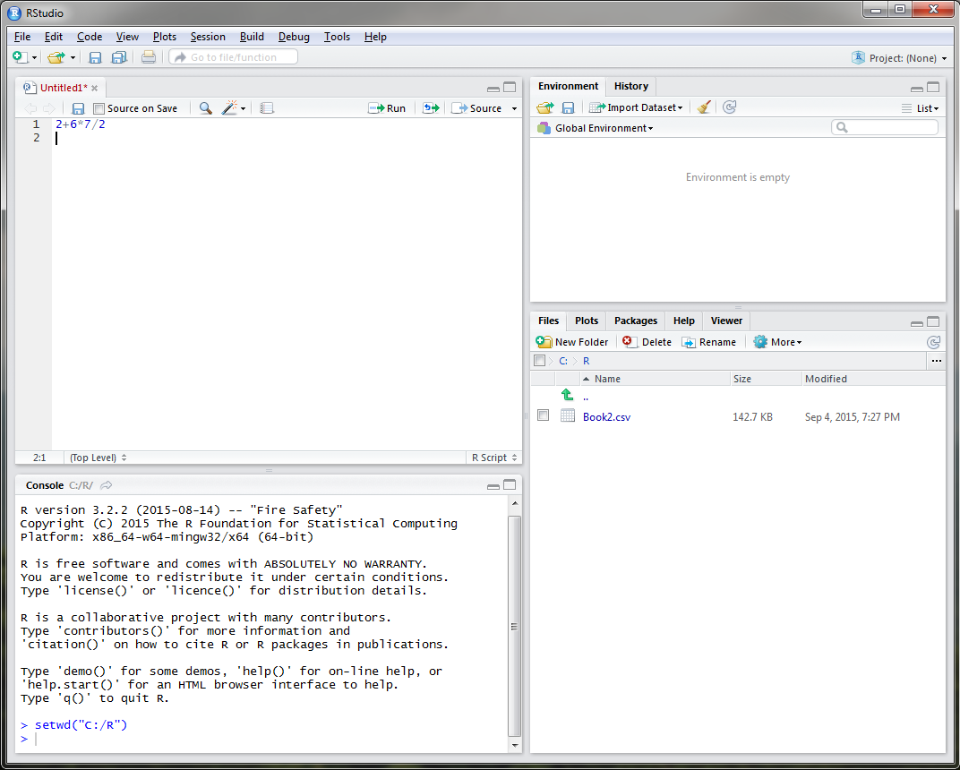
RStudio
Notes:
R can be used as a calculator to solve simplistic mathematical equations like the one currently displayed, as a GIS, for statistical analysis, for sampling design, and for modeling. In order to execute the equation that I have typed, I must place my cursor on line 1 or highlight line 1 and select the Run button.
-Click-
Notice that the answer to my equation is displayed in the console window in the bottom left and the command is added to the History tab.

Slide 25
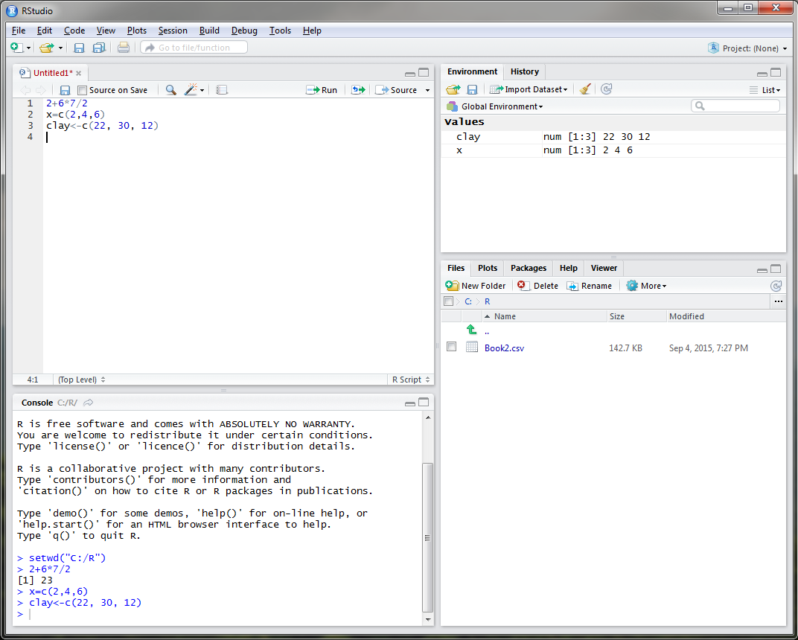
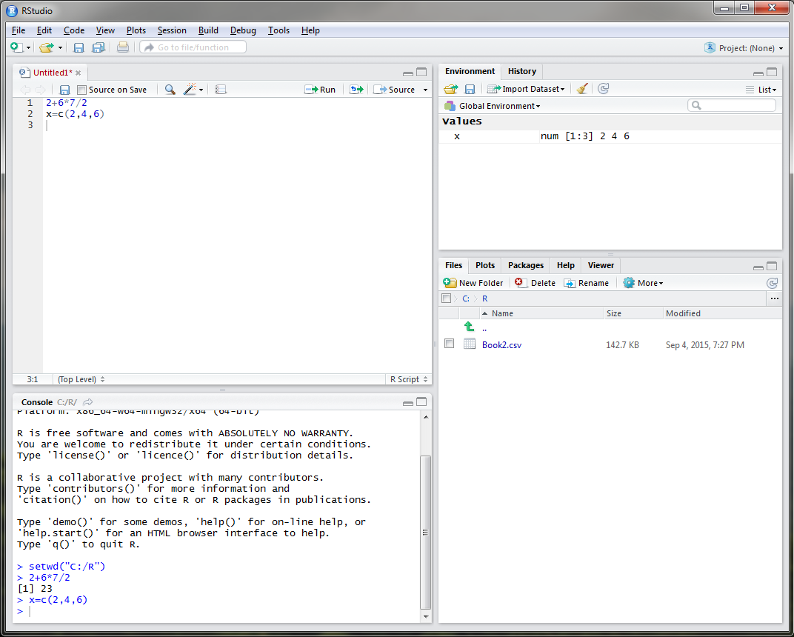
RStudio - Objects
object <- function
object = function
Notes:
In R you can assign almost anything as an object, including a single number or letter, model, settings, or dataset. For example, say I wanted to create an object entitled x that displayed rock fragment content of 3 different sites. I could do this in R by typing, x equals the concatenate function that links together the rock fragment values of 2, 4, and 6. Objects are displayed in the Environment tab in the upper right corner. In order to create an object in R, you must use either the = sign or a less than with a dash, either is fine. It is personal preference.
-Click-
Let’s create an object called clay to represent the clay content at these three sites.

Slide 26
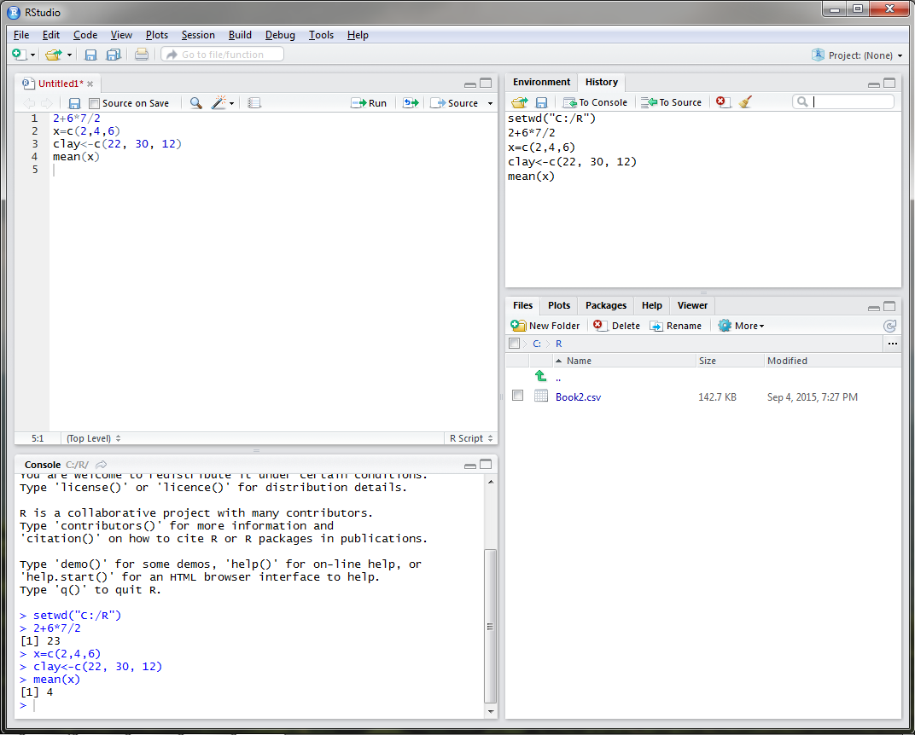
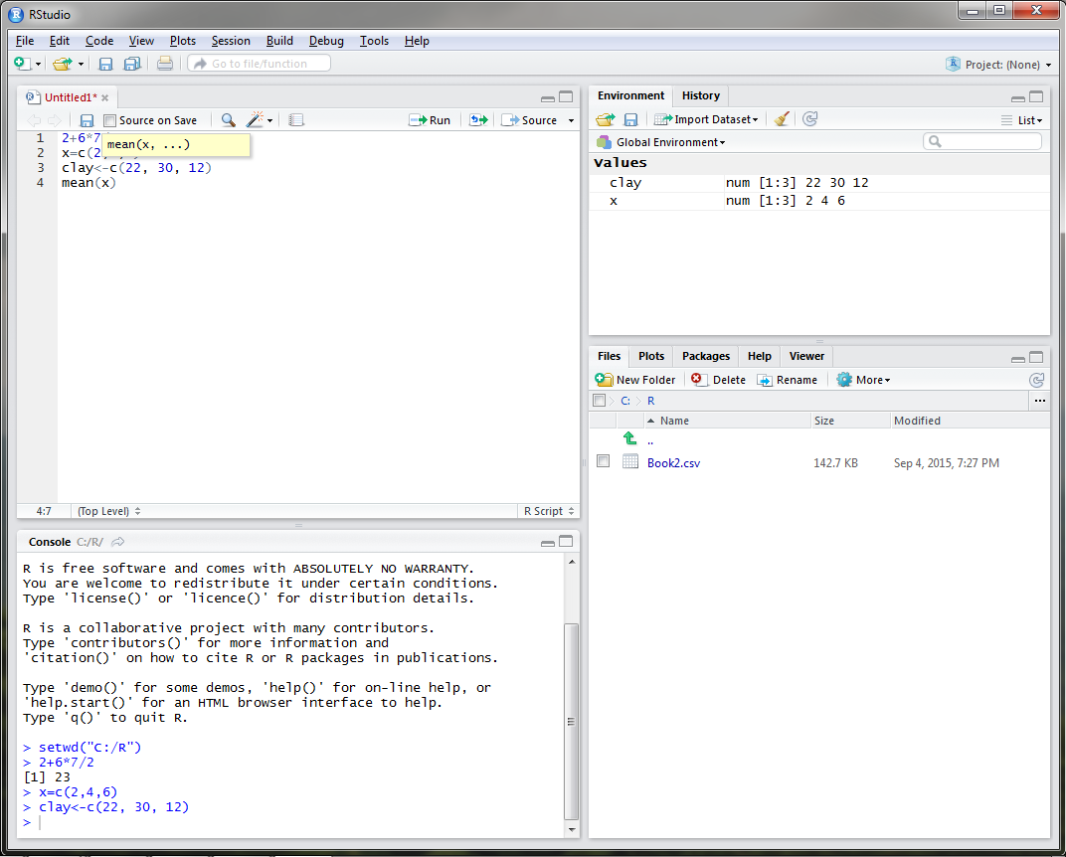
RStudio
Notes:
Say we wanted to know the mean of our rock fragment content. The function for mean is conveniently mean in R, so you would type mean with x (our rock fragment dataset) in parenthesis.
-Click-
Once you run this command, the answer is displayed in the console as 4 and the function is added to the R history tab. When you type a function in RStudio, a drop down menu will open that will list all available functions with the term that you type.

Slide 27
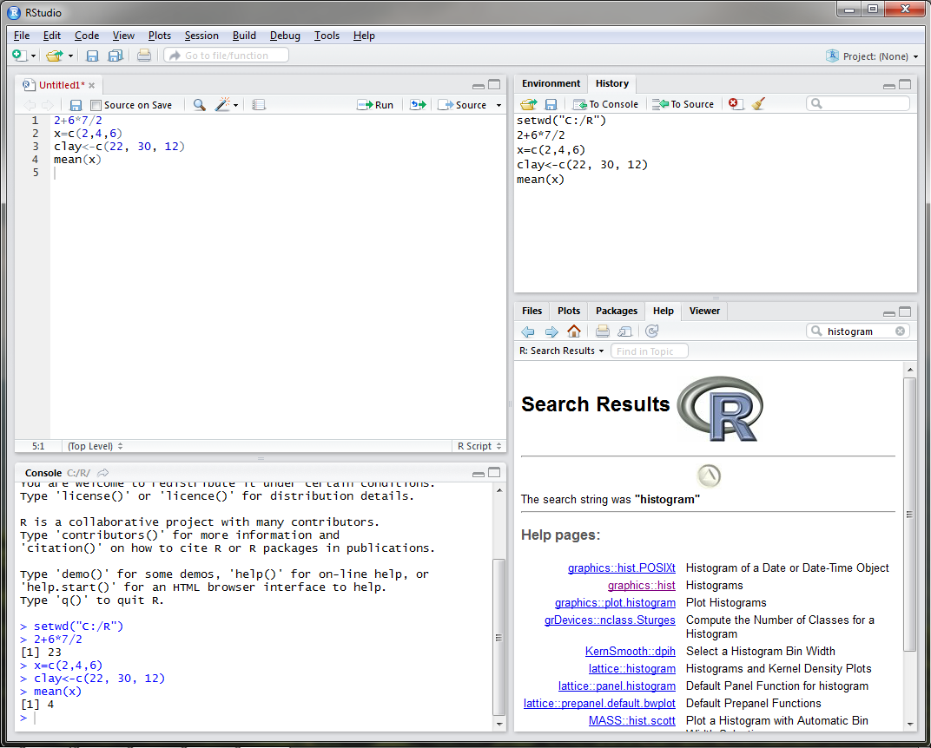
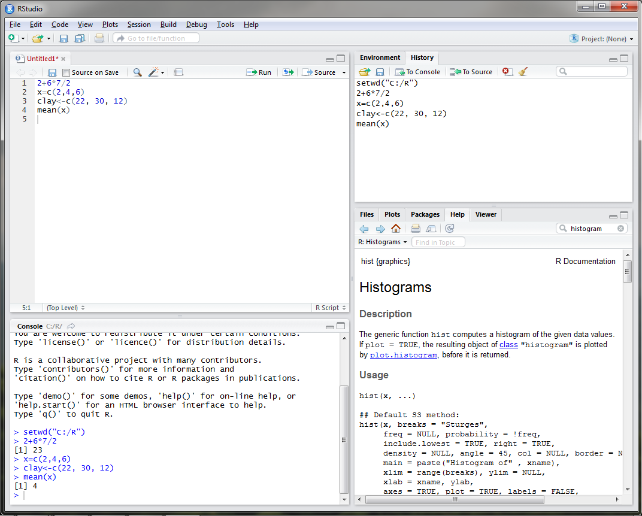
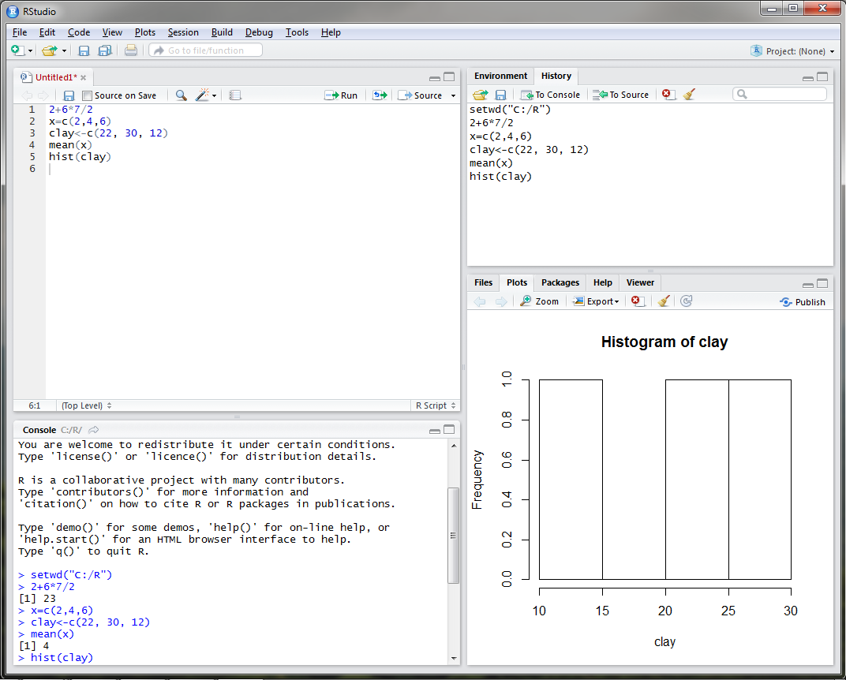
RStudio
Notes:
What if I wanted to view the distribution of clay content? What function would I use? If I was unsure, I could use the Help tab in the bottom right and search for histogram.
-Click-
If I click on the graphics: hist link, a webpage describing the hist function appears.
-Click-
If I execute the hist command for clay content, you can see that a plot is generated in the plot tab in the bottom right.

Slide 28
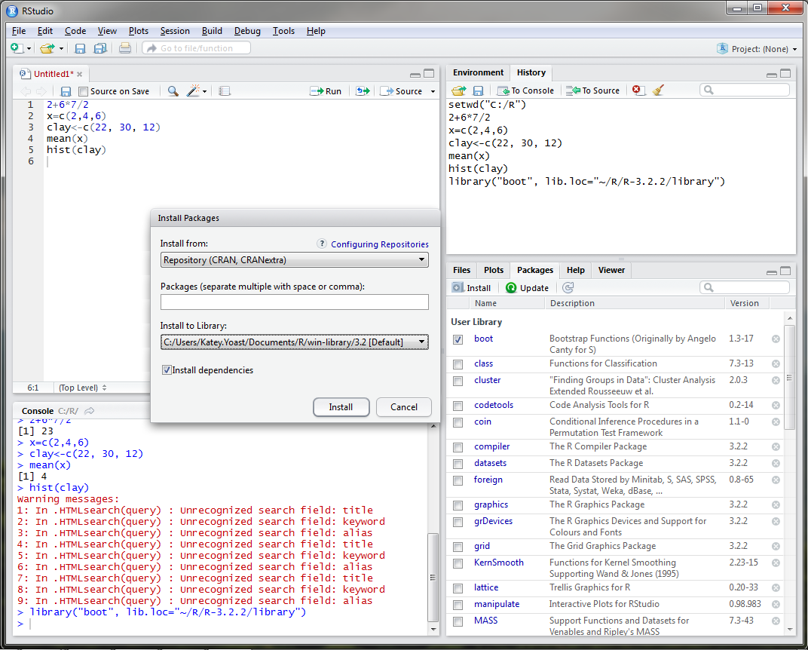
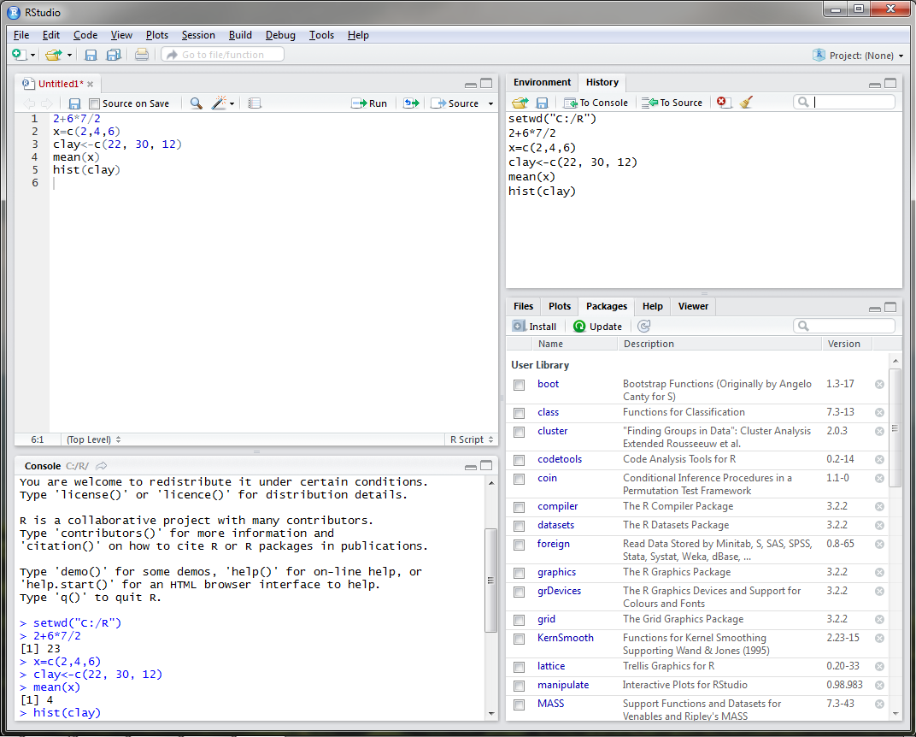
RStudio – Installing Packages
Notes:
One thing that I have yet to mention is that both R programs are equipped with base packages that contain functions such as hist and mean. Packages are simply collections of code developed by R users. There are currently over 7,300 packages developed for use in R. For user convenience, RStudio developed a Packages tab in the lower right window that lists all of the packages that have been installed. In order to utilize these packages, the user must load them either by using the library() function or by checking the box next to the package name in the Packages tab.

Slide 29
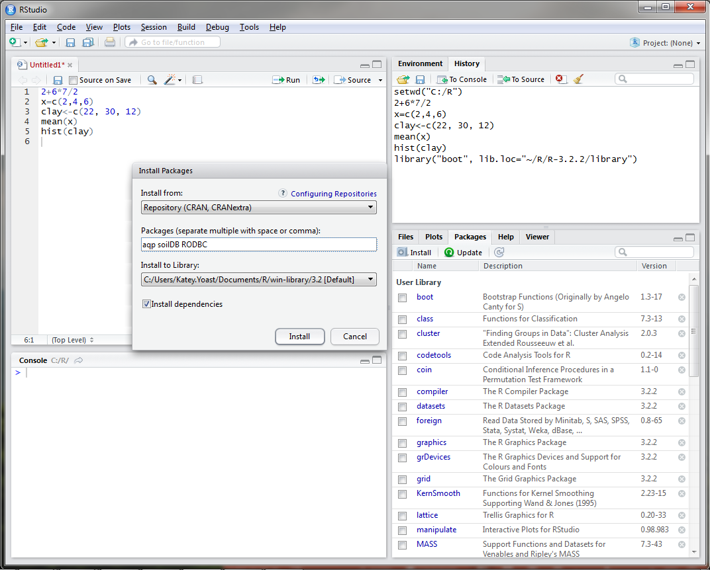
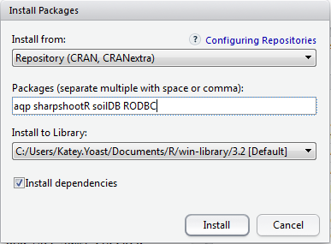
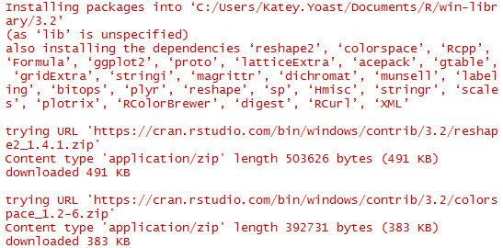
RStudio – Installing Packages
Notes:
It may be necessary to install several packages that are not listed under the Packages tab. With no packages selected, click on Install under the Packages tab. In the packages text line, we will type four packages that have been used for soil survey applications, the aqp, sharpshootR, soilDB, and RODBC packages. Packages only need to be installed the first time you use them on your machine.
-Click-
Notice that the packages that we have installed depend and utilize many other packages that were also installed on our machine. It is important to always check the install dependencies box when installing a package in R.
AQP – visualization, aggregation, classification
soilDB – access to commonly used soil databases
SharpshootR – misc. soil survey specific functions
RODBC - ODBC Database Access

Slide 30
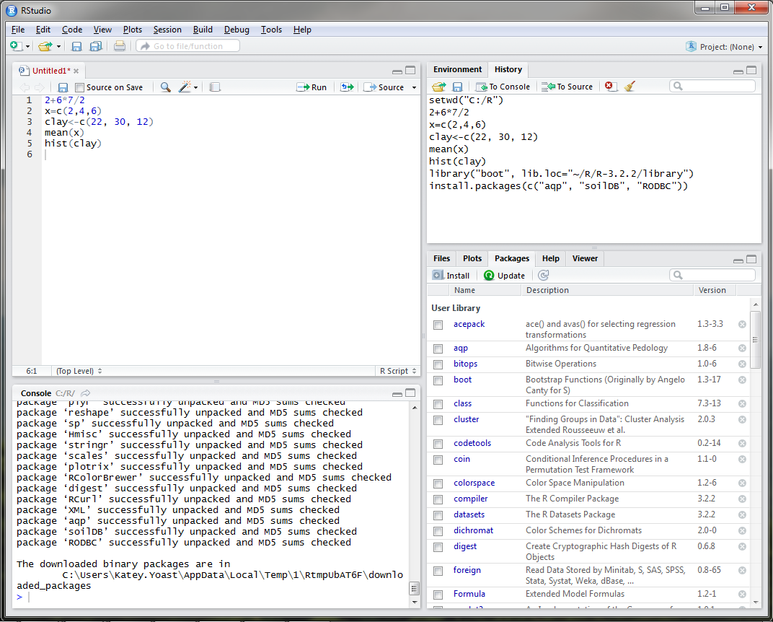
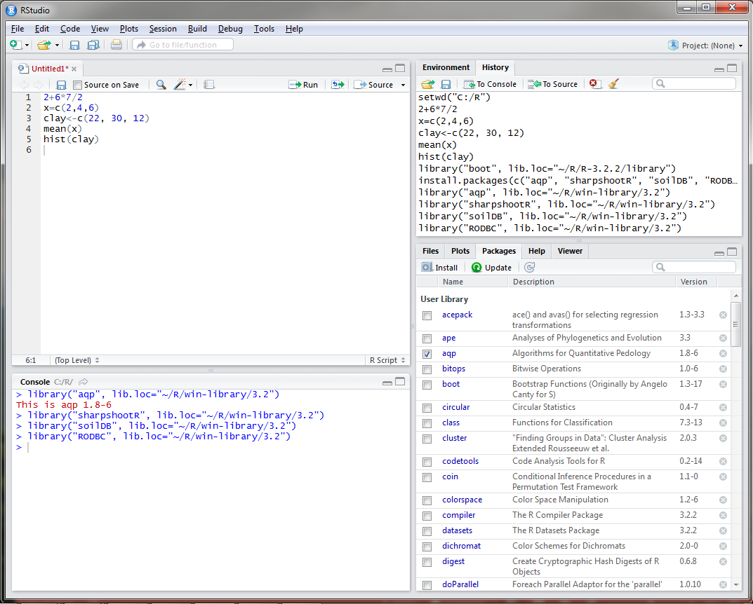
RStudio – Installing Packages
Notes:
Once installed, the packages are added to the Package tab in the bottom right corner. You can update packages when necessary by clicking on the Update icon in the Packages tab. Updates are available fairly often depending on the package, so it is important to keep packages updated. Every time you open RStudio, you will need to load the packages that you are going to use during your R session by checking the box next to the package name.
All packages in R are required to meet certain standards set by The Comprehensive R Archive Network, including documentation, sample datasets, and examples. Once you find a package that will accommodate the functions that you wish to run, it is simply a matter of reading the documentation and viewing the examples to understand how to apply the function to your data. Since R is an open source program, there are a TON of resources available online.

Slide 31
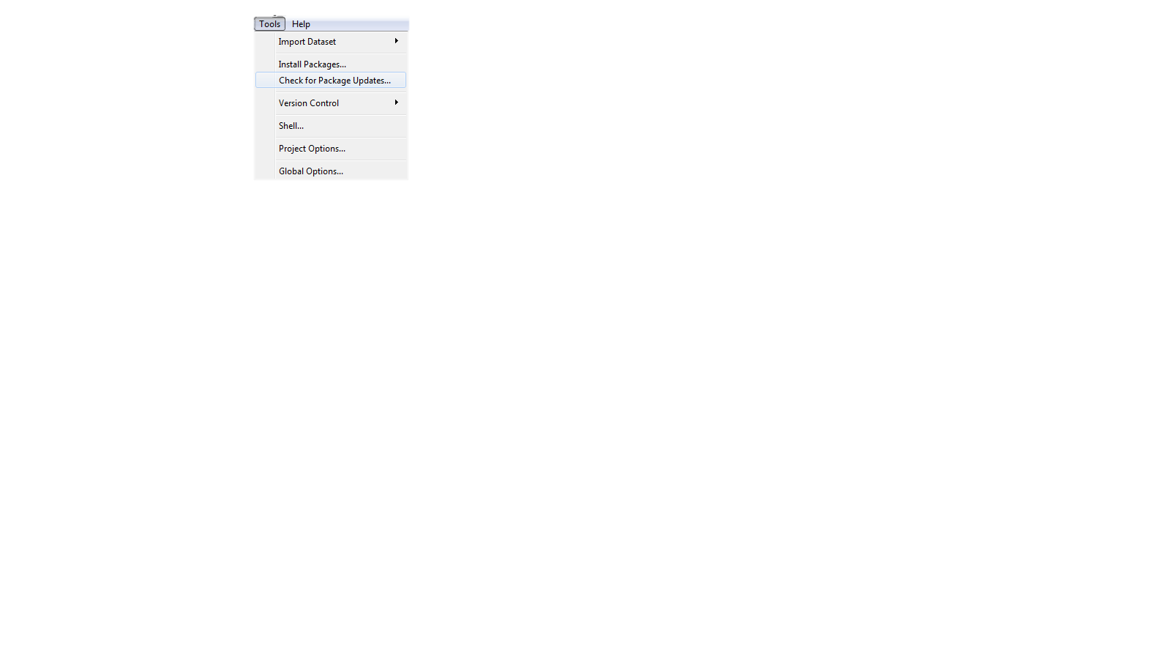
RStudio – Installing Packages
Notes:
You can also install and update packages using the Tools drop down menu.

Slide 32
Pre-course Assignment: Open Database Connection (ODBC)
Links a local NASIS database to R so that pedon and DMU records can be queried with the soilDB package in RStudio.
Only needs to be done once on your machine.
Suggested NASIS queries to run:
Pangaea query POINT - Pedon/Site/Transect by Current Taxon Name. This accepts a Taxon Name, for example, Gauley.
Pangea query POINT - Pedon/Site by Correlated Name.
Pangea query POINT - Pedon/Site/Transects by User Pedon ID (2100 Max).This accepts a comma delimited list, for example, 95IL151005E, 94IL153001, 95IL153001, 92IL163017.
Pangea query POINT - Pedon/Site/Transects by Pedon Rec ID (2100 Max).This accepts a comma delimited list, for example, 44249, 175077, 101806, 44411.
Pangea query POINT - PedonHorizon/Site/Transect by HorizonRecID (2100 Max). This accepts a comma delimited list, for example, 210618, 210619, 853291, 208951.
Notes:
In order to fetch data from NASIS, data must first be in your selected set. The NASIS queries displayed above are suggested by Tom and Stephen for loading data into your selected set.

Slide 33
EXERCISE
https://github.com/ncss-tech/stats_for_soil_survey/blob/master/chapters/1_introduction/1_introduction.md
Notes:
Let's take a 10 minute break and then we will run through some introductory examples in R.

